Slide 1


Supervised Machine Learning
Classification

Slide 2
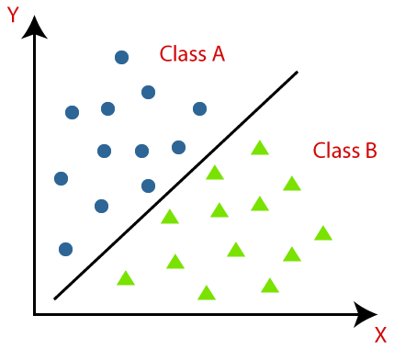
What is classification?
Supervised Machine Learning
The process of recognition, understanding, and grouping of objects and ideas into preset categories.
It utilizes input training data for the purpose of predicting the likelihood or probability that the data that follows will fall into one of the predetermined categories.

Slide 3
Logistic Regression

Slide 4
Logistic Regression
Statistical Model
Estimates the probability of an event occurring based on a given dataset of independent variables.
Three types - based on categorical response.
Binary logistic regression
Multinomial logistic regression
Ordinal logistic regression

Slide 5
Binary logistic regression
The most commonly used among three logistic regressions
The most common classifiers for binary
Only two possible outcomes {0 or 1}.
0: Negative Class 1: Positive Class
Examples:
Predict if an e-mail is spam or not spam
Predict if a person will survive or not in an event

Slide 6
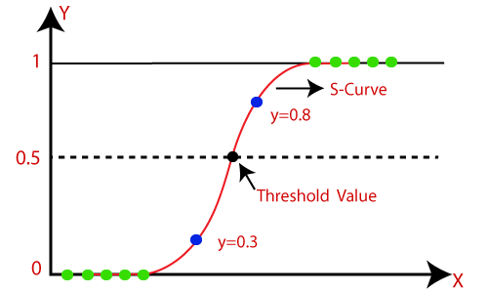

Binary logistic regression
Hypothesis Representation: 0 <= h_{θ}(x) <= 1
"x” is input and “y” is output.
Threshold classifier output, h_{θ}(x) at 0.5
If h_{θ}(x) >= 0.5, predict y = 1
If h_{θ}(x) < 0.5, predict y = 0

Slide 7



Binary logistic regression
Sigmoid Function
A function that map between 0 and 1
Logistic Function

Slide 8
Multinomial logistic regression
The dependent variable has three or more possible outcomes; however, these values have no specified order.
Example:
Predict what genre of film a moviegoer is likely to see to market films more effectively. A multinomial logistic regression model can help the studio to determine the strength of influence a person's age, gender, and dating status may have on the type of film that they prefer. The studio can then orient an advertising campaign of a specific movie toward a group of people likely to go see it.

Slide 9
Multinomial logistic regression
It uses softmax function.
Softmax function determines the class with highest probability.
The class that has highest probability value is the winner and it is the output label of the input data.
Example:
Input is an image of a car, the possible results are as follows.
Bicycle: 0.15
Truck: 0.35
Car: 0.50
Total value of the probability of all label = 1.00
The car has highest probability value. Therefore, it wins.
The output label is the car.

Slide 10
Multinomial logistic regression
Class 1
P = 0.7
Input
Output
Class 2
P = 0.2
P = Probability
Class 3
P = 0.1

Slide 11
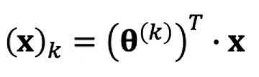
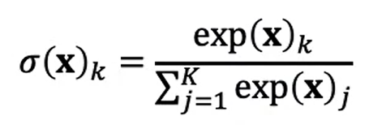

Multinomial logistic regression
It computes the scores.
k is the class (label of each type)
θ is the model parameter
x is the feature values
score
σ is the probability that (x) belong to class k given the earlier score
K is the total number of score.
Soft Max function

Slide 12
Ordinal logistic regression
It is leveraged when the response variable has three or more possible outcome, but in this case, these values do have a defined order.
Examples:
Grading scales from A to F
Rating scales from 1 to 5

Slide 13
When to apply Logistic Regression
Almost always, as a baseline though! Logistic Regression make an assumption based on linearity and as long as your data is approximately linear, Logistic Regression work fantastic. There are also some clear advantages:
Advantages:
They are quite fast for both training and prediction
They have very few (if any) tunable parameters
Descent algorithms works well with Logistic Regression
Disadvantages:
The only problem of Logistic Regression lies on its limitation of linearity.

Slide 14
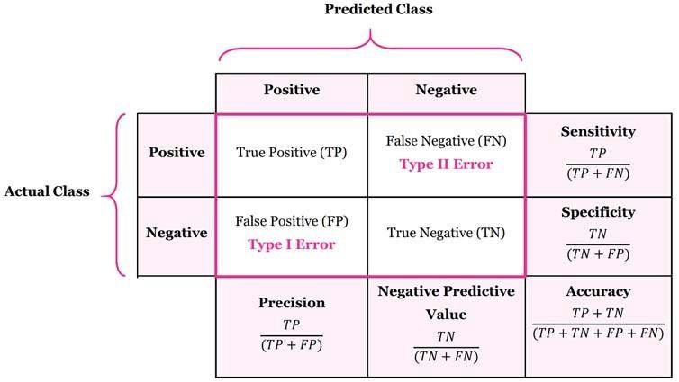
Classification Performance Measurements Parameters
TN / True Negative:
when a case was negative and predicted negative
TP / True Positive:
when a case was positive and predicted positive
FN / False Negative:
when a case was positive but predicted negative
FP / False Positive:
when a case was negative but predicted positive

Slide 15
Classification Performance Measurements Parameters
Classification Report
Precision – Accuracy of positive predictions.
Precision = TP/(TP + FP)
Recall: Fraction of positives that were correctly identified.
Recall = TP/(TP+FN)
F1 Score: What percent of positive predictions were correct?
F1 Score = 2*(Recall * Precision) / (Recall + Precision)
Support: The number of actual occurrences of the class in the specified dataset.

